Slide 1
ABC Learning Design
PowerPoint Based Curriculum Design Storyboard

Slide 2

In association with the
Please view this presentation in full screen slideshow mode
(click F5 on the keyboard or select the Slide Show icon)
Section 3 contains animations that help to understand the process
IUA Enhancing Digital Teaching & Learning project

Slide 3
Overview
The Process
Learning Types Cards – larger view of front & back of cards
Storyboarding Example
Smaller sized cards – for copying and pasting onto storyboard
Blank Storyboard

Slide 4
1. The Process
In your module or programme teams, discuss the topics and sub-topics for each week using the storyboard timeline
Map learning types to the storyboard:
Firstly, consider the associated Learning Types Cards (front) and discuss what might work well for each week
After initial discussion and consideration, copy and paste the relevant smaller sized learning types cards (front) onto your blank storyboard timeline
Map associated activities to the storyboard:
Next, once discussions and considerations have advanced, consider the activities on the back of the cards that are associated with the learning types you have selected
Copy and paste the relevant smaller sized cards (back) onto your blank storyboard timeline
Discuss what available tools and technologies will help you to realise your storyboard

Slide 5
2. Learning Types Cards
Larger view of front & back of cards

Slide 6
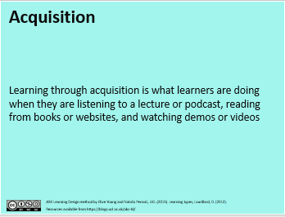
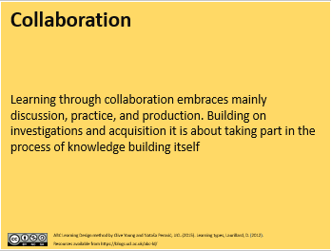
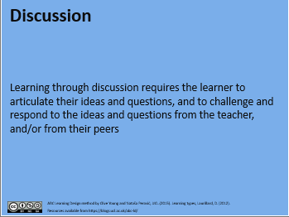
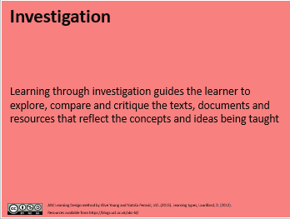
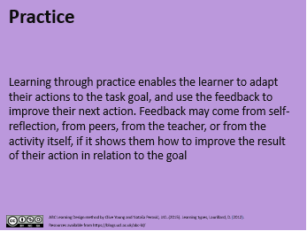
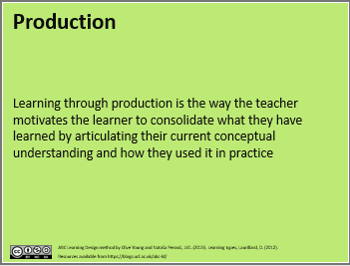
2. Learning types cards (front – 6 types)
Learning types on front side of card and sample activities on the back

Slide 7
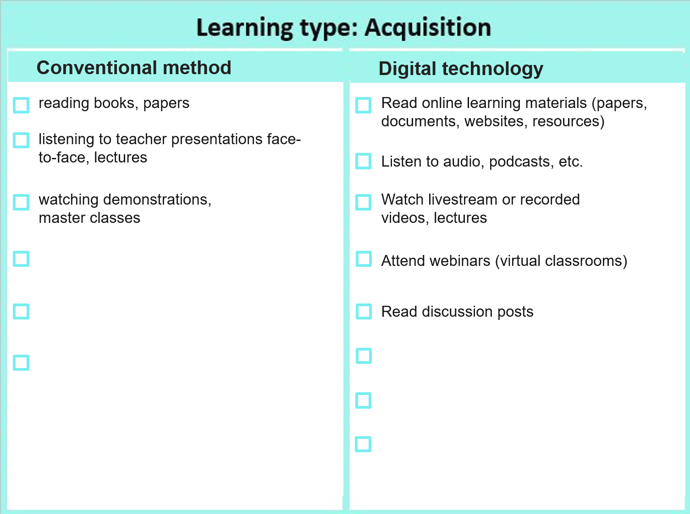
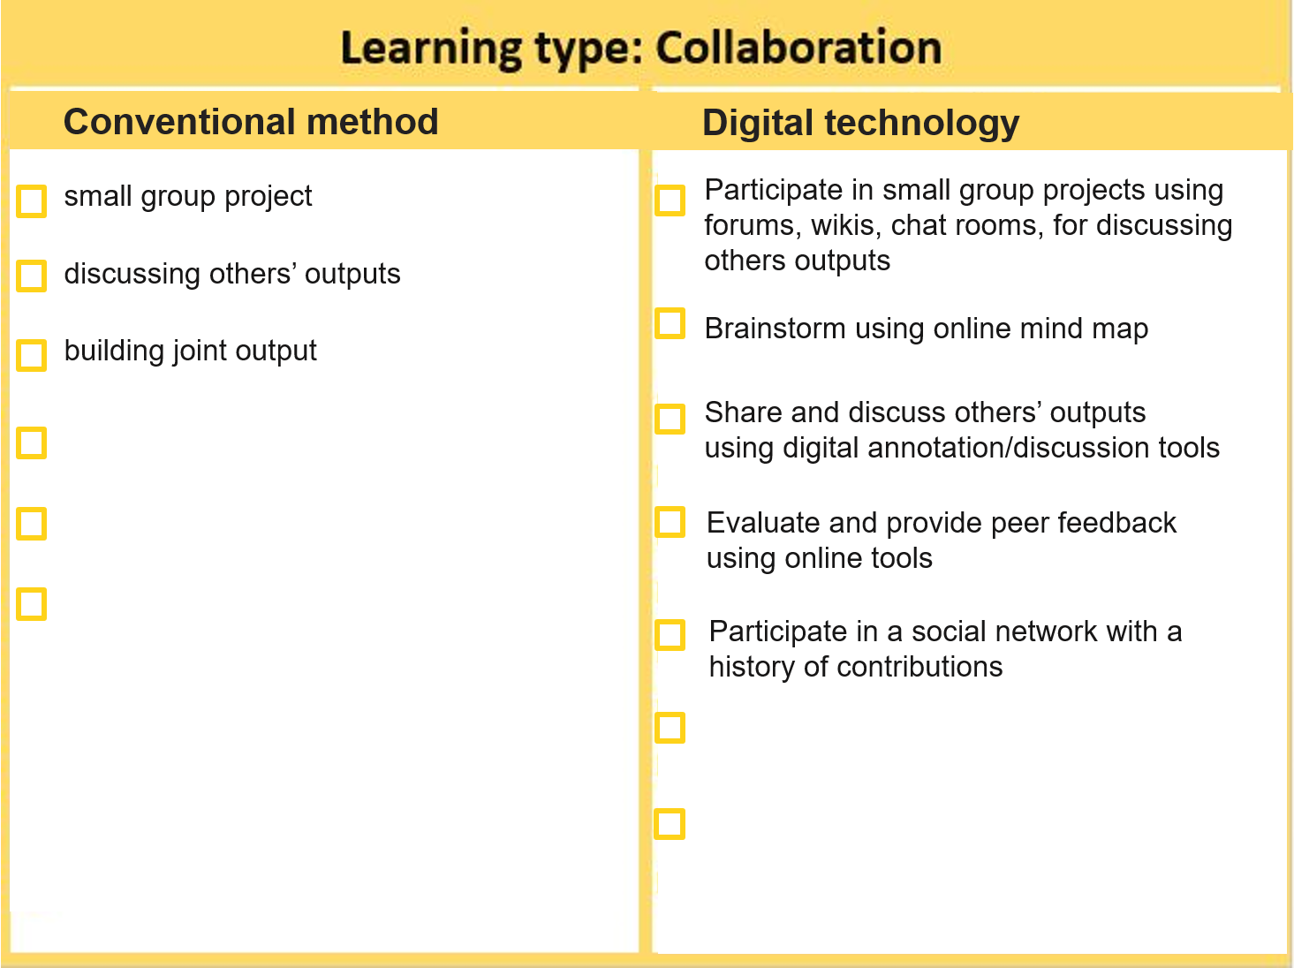
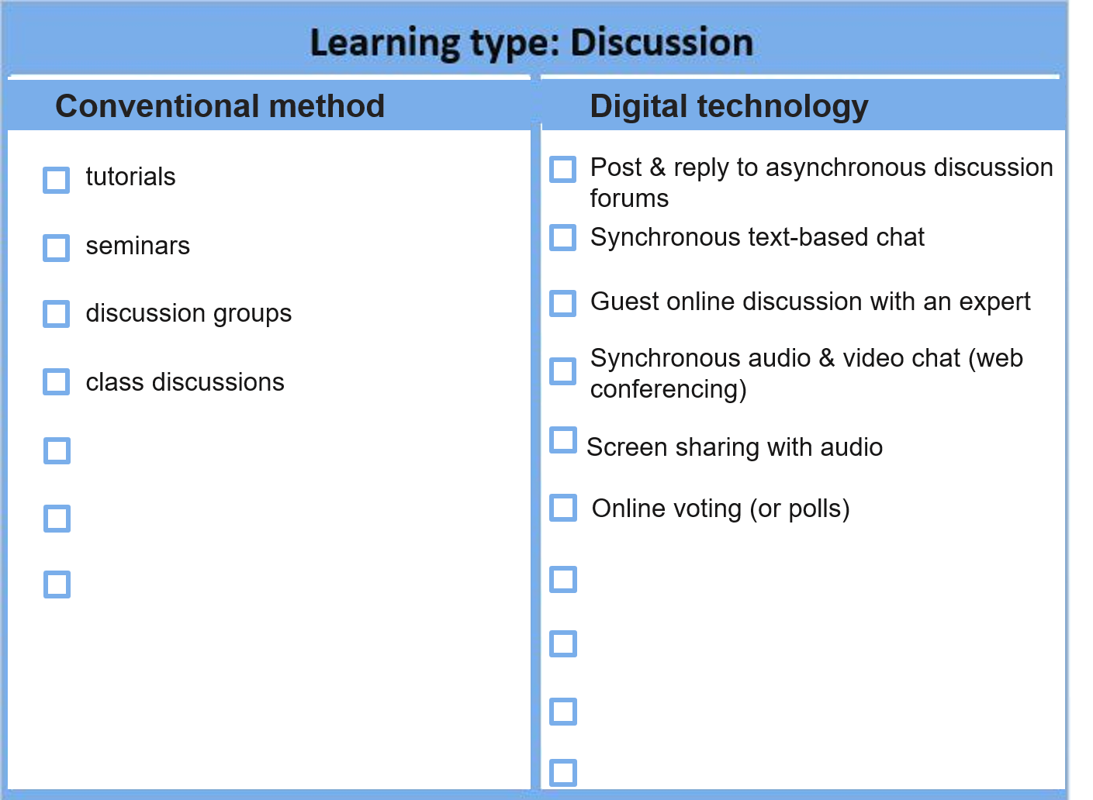
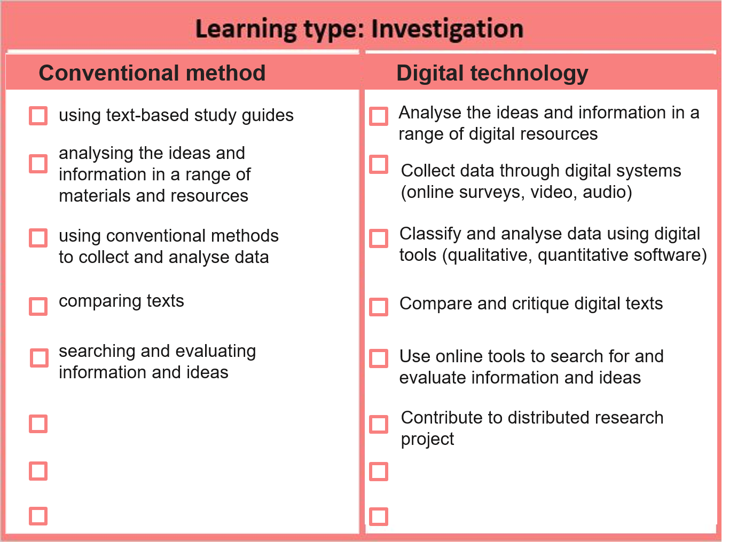
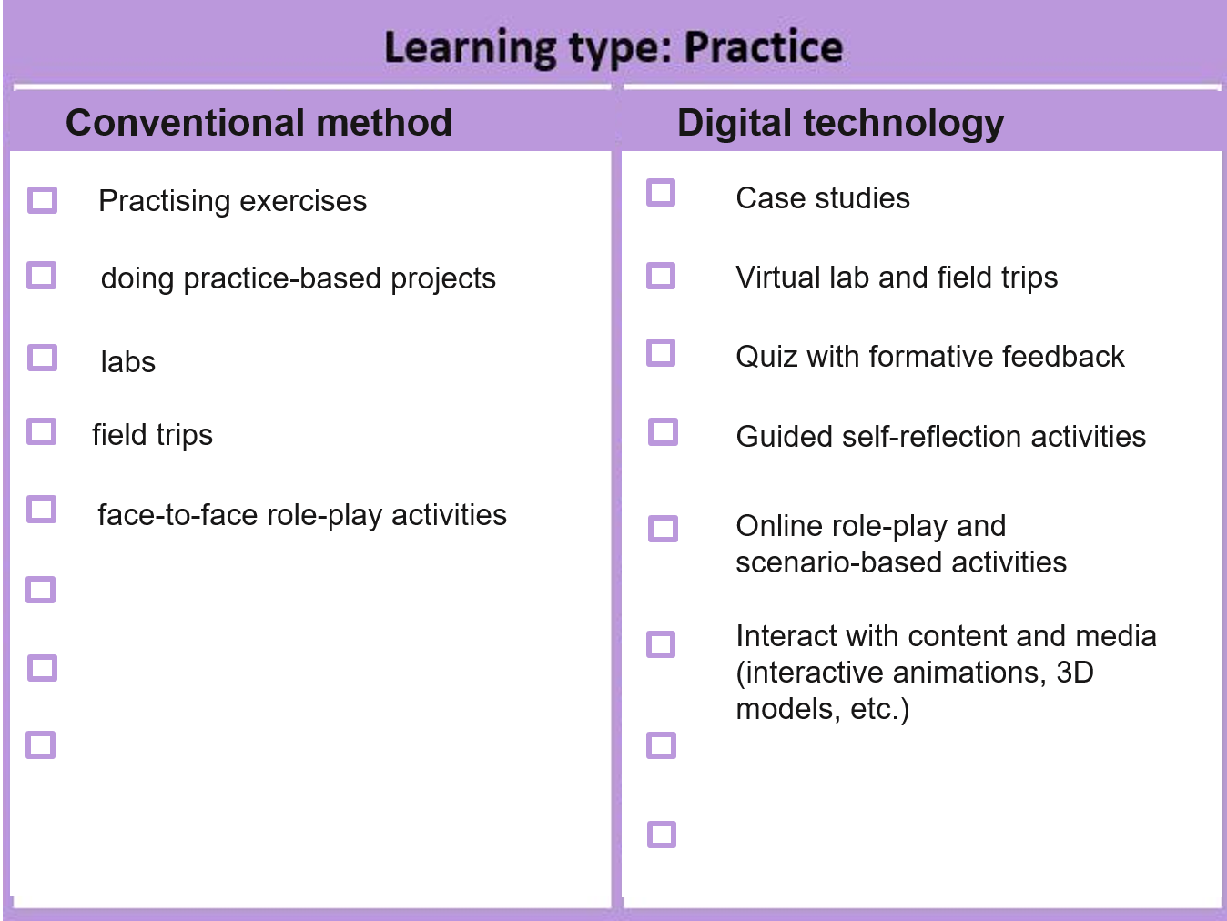
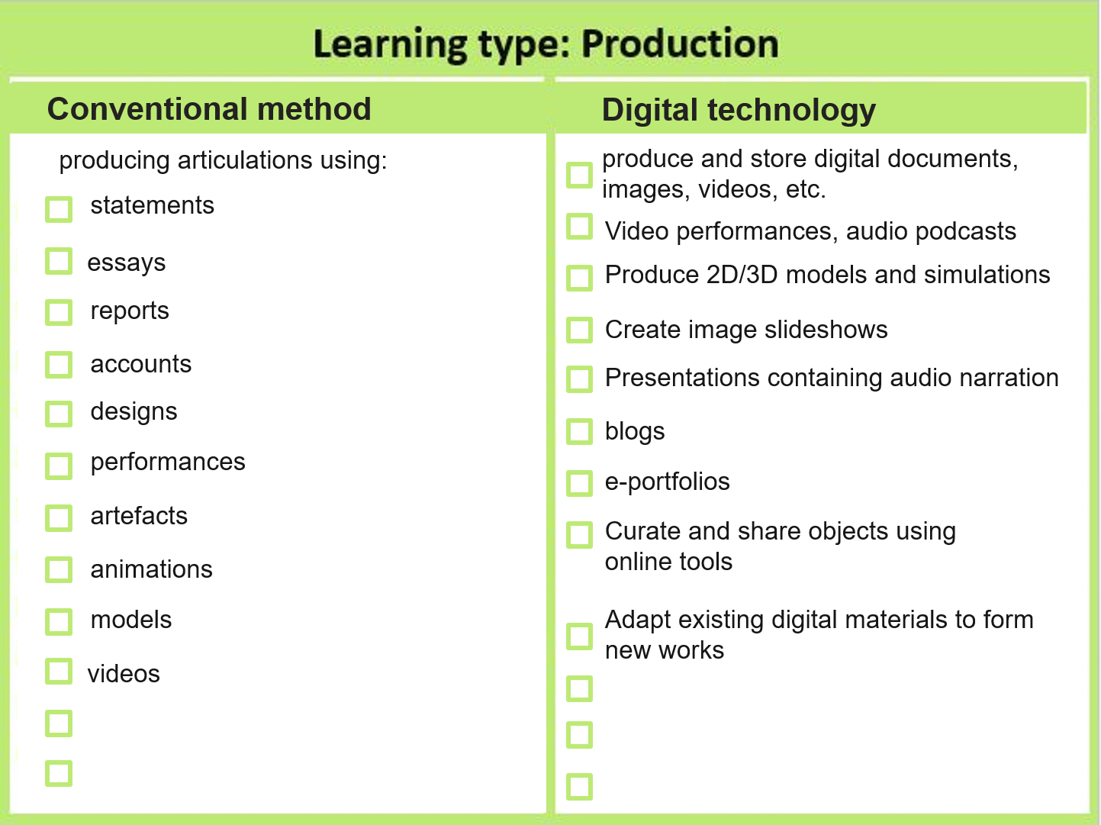
2. Learning types cards (back - activities)
Learning types on front side of card and sample activities on the back

Slide 8
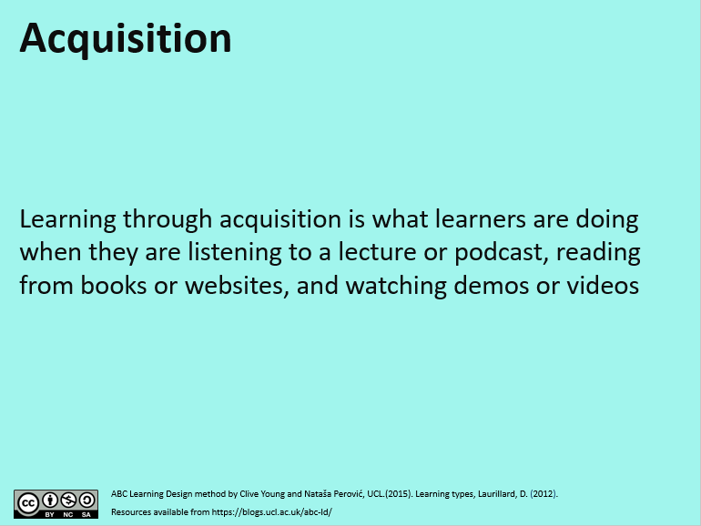
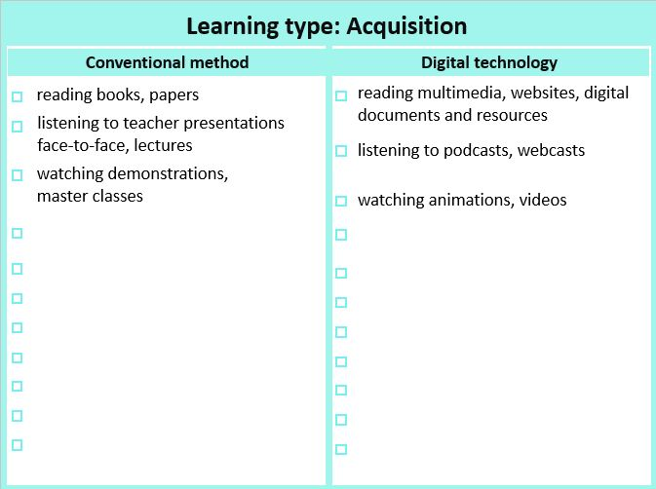

Conventional method
Reading books, papers;
Digital technology
reading books, papers
Read online learning materials (papers, documents, websites, resources)
listening to teacher presentations face-to-face, lectures
Listen to audio, podcasts, etc.
watching demonstrations,
master classes
Watch livestream or recorded videos, lectures
Attend webinars (virtual classrooms)​
Read discussion posts

Slide 9
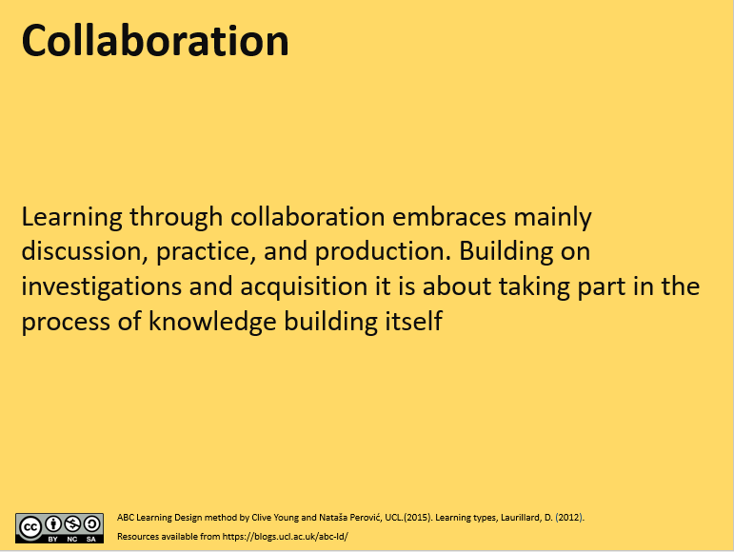
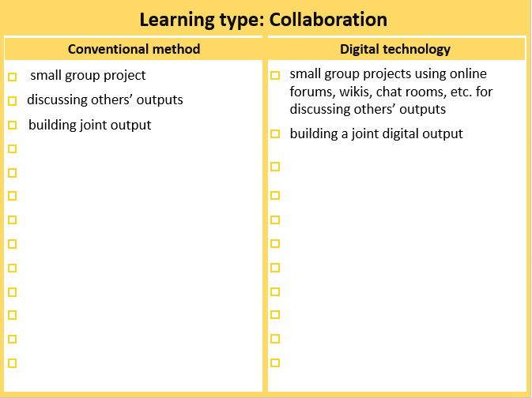
Conventional method
Digital technology
Reading books, papers;
small group project
Participate in small group projects using forums, wikis, chat rooms, for discussing others outputs
discussing others’ outputs
building joint output
Brainstorm​ using online mind map
Share and discuss others’ outputs
using digital annotation/discussion tools
Evaluate and provide peer feedback
using online tools
Participate in a social network​ with a
history of contributions

Slide 10
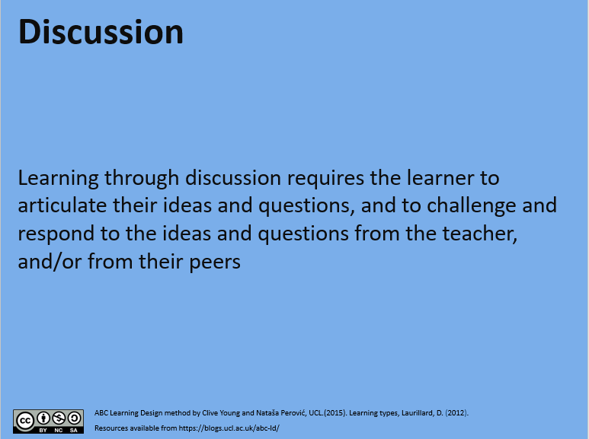
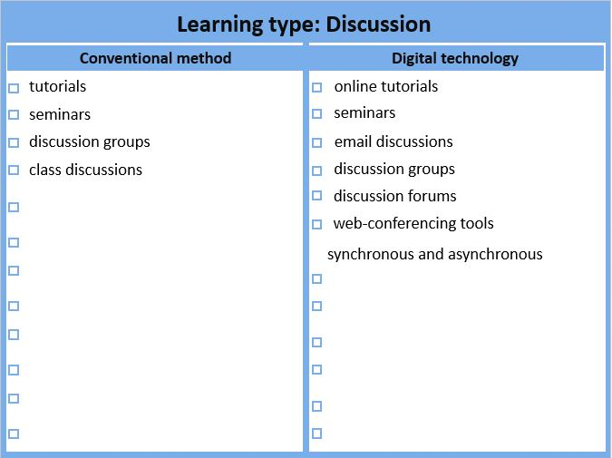
Reading books, papers;
Digital technology
Conventional method
tutorials
Post & reply to asynchronous discussion forums
seminars
Synchronous text-based chat
discussion groups
Guest online discussion with an expert
class discussions
Synchronous audio & video chat (web conferencing)
Screen sharing with audio
Online voting (or polls)

Slide 11
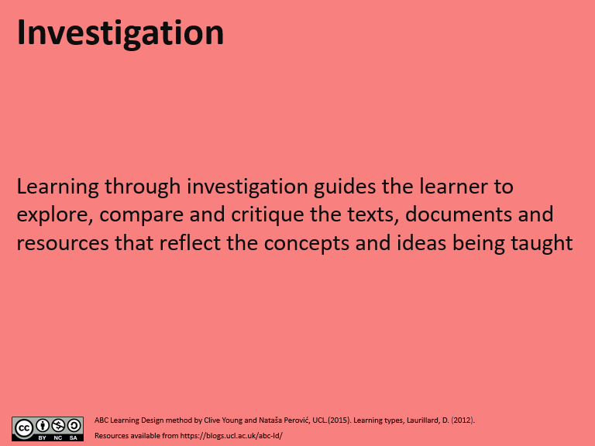
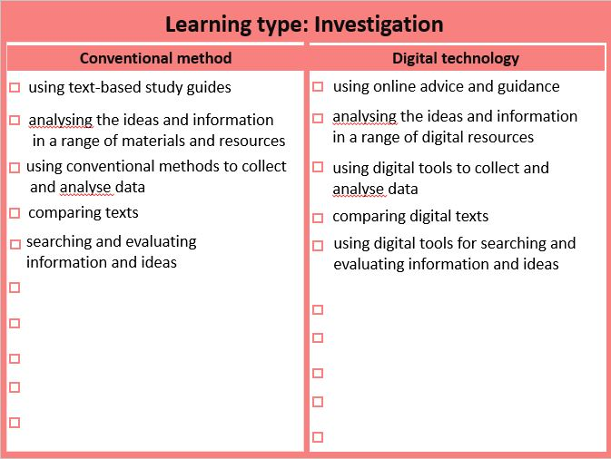
in a range of materials and resources;
Using conventional methods to collect
Comparing texts, searching and evaluating information and ideas.
Conventional method
Digital technology
using text-based study guides
Analyse the ideas and information in a range of digital resources
analysing the ideas and
information in a range of
materials and resources
Collect data through digital systems (online surveys, video, audio)
using conventional methods
to collect and analyse data
Classify and analyse data using digital tools (qualitative, quantitative software)
comparing texts
Compare and critique digital texts
searching and evaluating
information and ideas
Use online tools to search for and evaluate information and ideas
Contribute to distributed research project

Slide 12
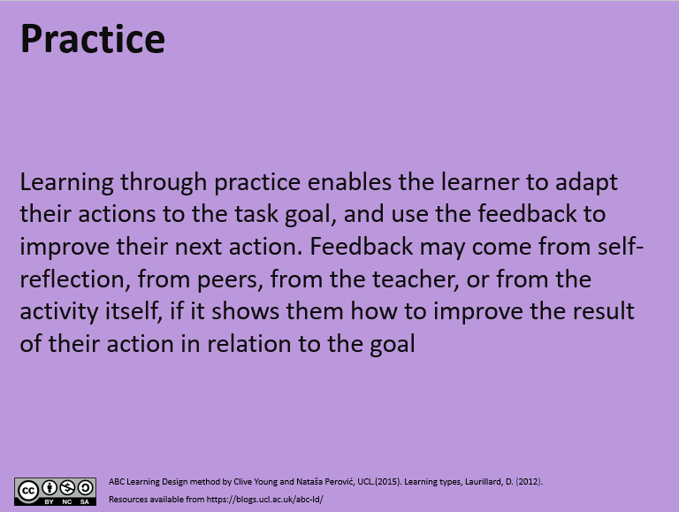
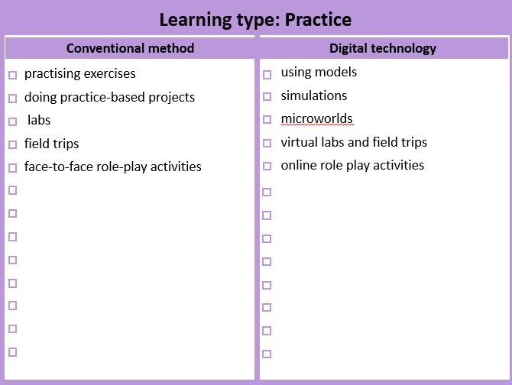
Conventional method
Digital technology
Reading books, papers;
Practising exercises
Case studies
doing practice-based projects
Virtual lab and field trips
labs
Quiz with formative feedback
field trips
Guided self-reflection activities
face-to-face role-play activities
Online role-play and scenario-based activities
Interact with content and media (interactive animations, 3D models, etc.)

Slide 13
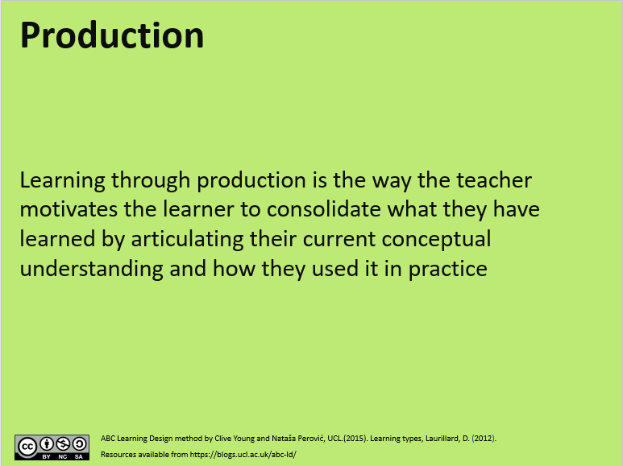
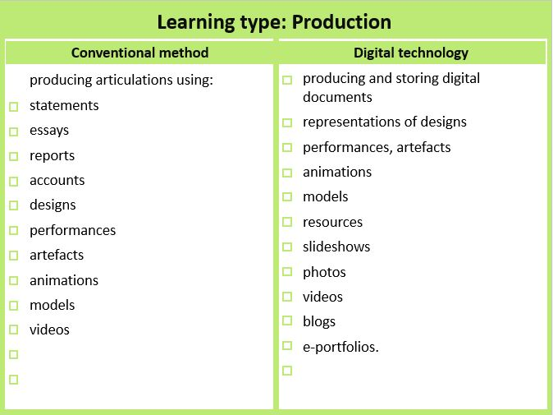
Conventional method
Digital technology
Reading books, papers;
producing articulations using:
produce and store digital documents, images, videos, etc.
statements
Video performances, audio podcasts
essays
Produce 2D/3D models and simulations
reports
Create image slideshows
accounts
Presentations containing audio narration
designs
blogs
performances
e-portfolios
artefacts
Curate and share objects using online tools
animations
models
Adapt existing digital materials to form new works
videos

Slide 14
3. Storyboarding Example

Slide 15
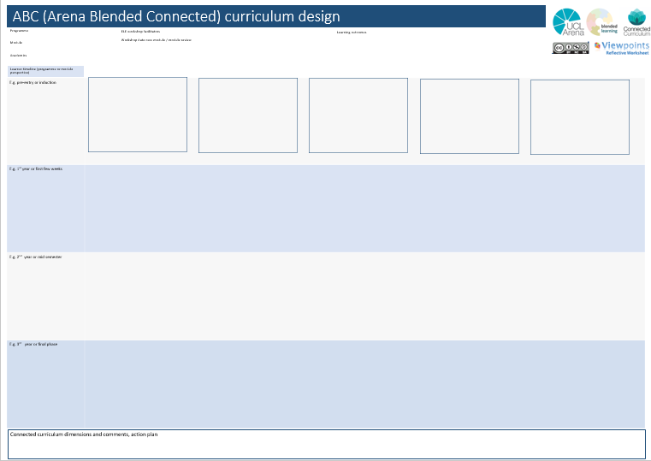

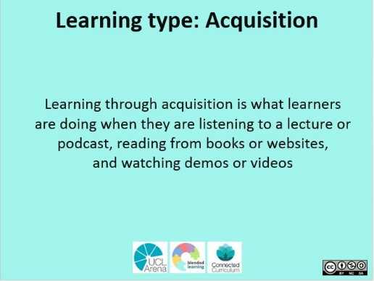
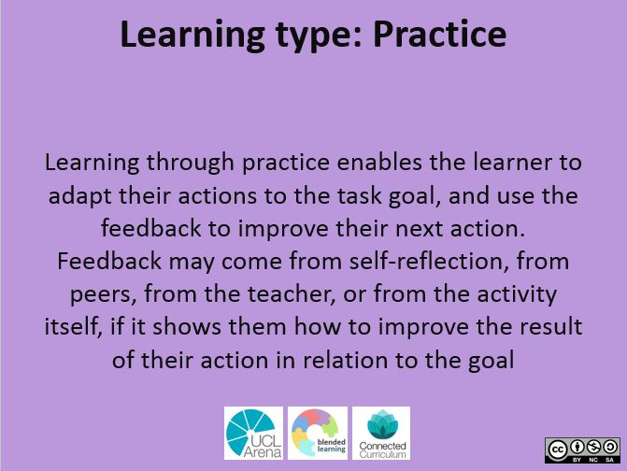
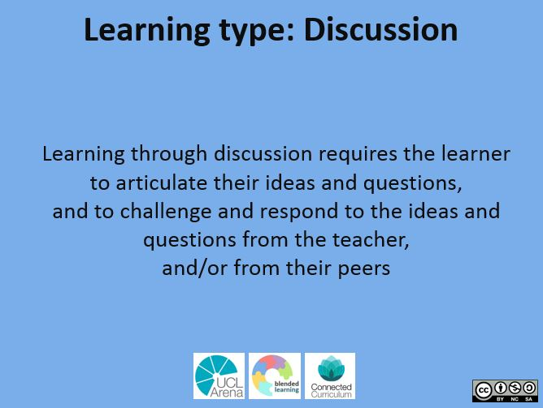
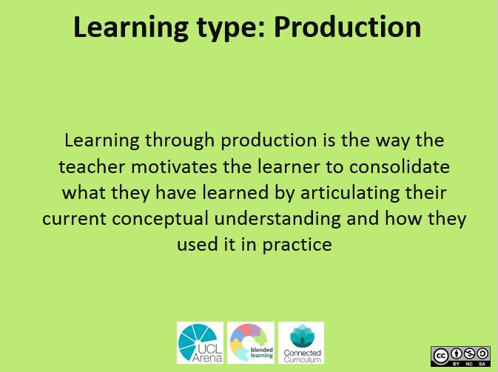

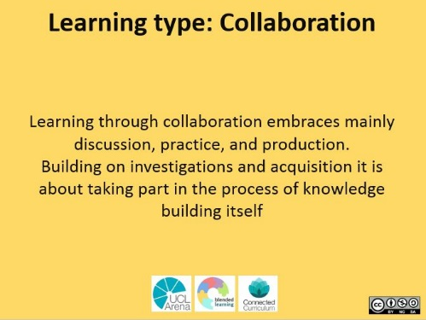
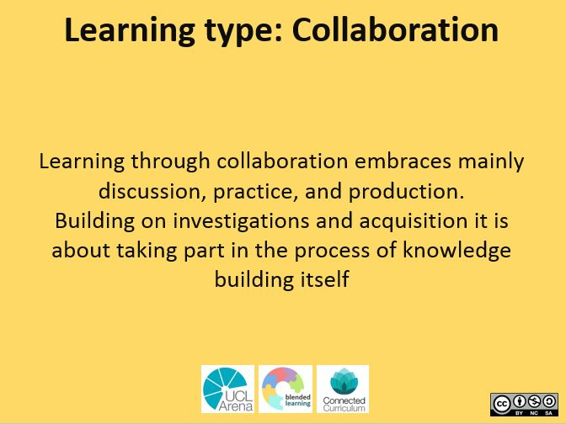

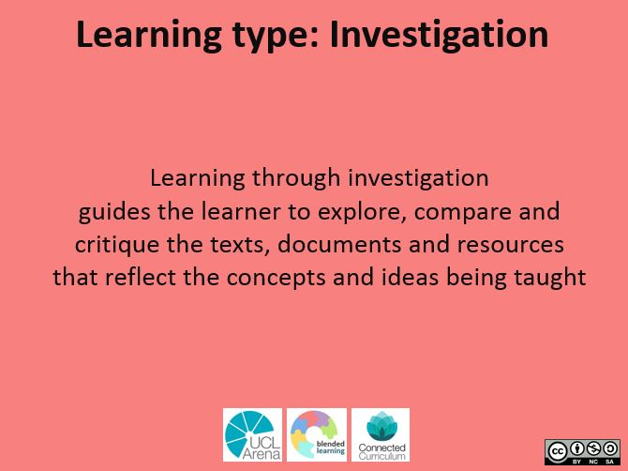
ABC Learning Design
Week
1-4
Week
5-8
project

Slide 16
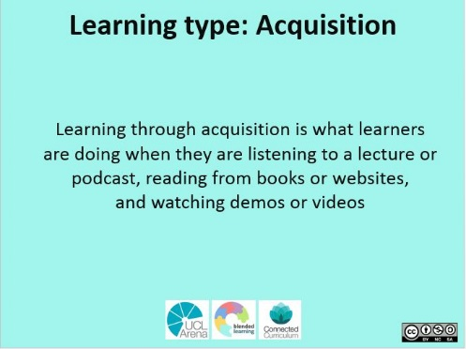
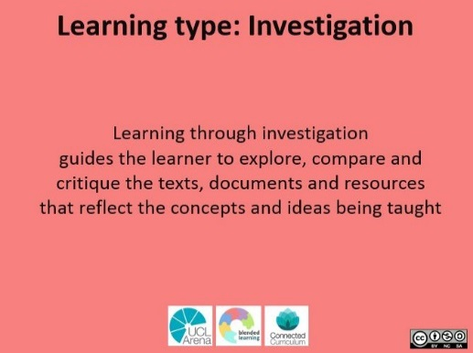
ABC Learning Design
Your module may look like this
Week
1-4
Week
5-8
project
reflection

Slide 17
ABC Learning Design
Your module may look like this
Week
1-4
Once happy with your module design, turn the cards to the other side and select learning activities
Week
5-8
project
reflection

Slide 18

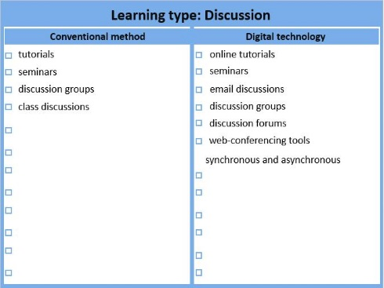
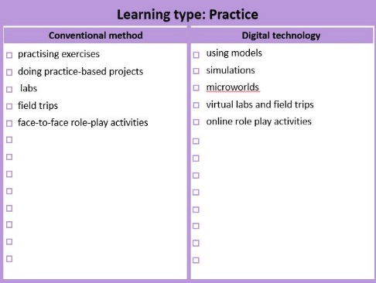
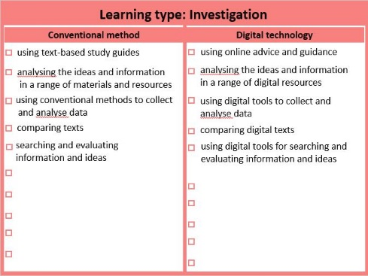
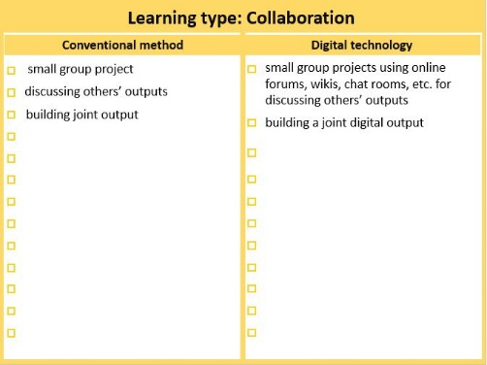
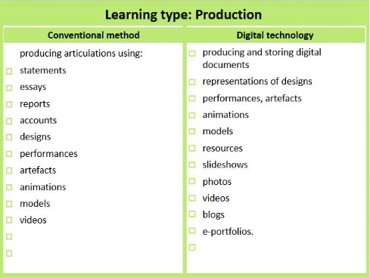
ABC Learning Design
Your module may look like this
Week
1-4
Week
5-8
✓
Select learning activities
project
and
add your own activities
18
reflection

Slide 19
4. Smaller sized cards – for copying and pasting onto storyboard

Slide 20
4. Smaller sized learning types cards (front)
Learning types on front side of card and sample activities on the back

Slide 21
4. Smaller sized learning types cards (back)
Learning types on front side of card and sample activities on the back

Slide 22
5. Blank Storyboard
Copy and paste smaller sized cards onto this storyboard

Slide 23


ABC LD (Arena Blended Connected Learning Design)
Module/course/MOOC title
Lead
Date
Learner timeline
E.g. weeks or topic
E.g. weeks or topic
E.g. weeks or topic
E.g. weeks or topic
Notes
@ABCtoVLE
ABC Learning Design method by Clive Young and Nataša Perović, UCL. (2015). Learning types, Laurillard, D. (2012). Resources available from https://abc-ld.org
Storyboard worksheet adapted from Viewpoints Curriculum Design, University of Ulster. Available at http://wiki.ulster.ac.uk/display/VPR/

Slide 24
ABC LD (Arena Blended Connected Learning Design)
Module/course/MOOC title
Lead
Date
Learner timeline
E.g. weeks or topic
E.g. weeks or topic
E.g. weeks or topic
E.g. weeks or topic
Notes
@ABCtoVLE
ABC Learning Design method by Clive Young and Nataša Perović, UCL. (2015). Learning types, Laurillard, D. (2012). Resources available from https://abc-ld.org
Storyboard worksheet adapted from Viewpoints Curriculum Design, University of Ulster. Available at http://wiki.ulster.ac.uk/display/VPR/

Slide 25
ABC LD (Arena Blended Connected Learning Design)
Module/course/MOOC title
Lead
Date
Learner timeline
E.g. weeks or topic
E.g. weeks or topic
E.g. weeks or topic
E.g. weeks or topic
Notes
@ABCtoVLE
ABC Learning Design method by Clive Young and Nataša Perović, UCL. (2015). Learning types, Laurillard, D. (2012). Resources available from https://abc-ld.org
Storyboard worksheet adapted from Viewpoints Curriculum Design, University of Ulster. Available at http://wiki.ulster.ac.uk/display/VPR/

Slide 26
ABC LD (Arena Blended Connected Learning Design)
Module/course/MOOC title
Lead
Date
Learner timeline
E.g. weeks or topic
E.g. weeks or topic
E.g. weeks or topic
E.g. weeks or topic
Notes
@ABCtoVLE
ABC Learning Design method by Clive Young and Nataša Perović, UCL. (2015). Learning types, Laurillard, D. (2012). Resources available from https://abc-ld.org
Storyboard worksheet adapted from Viewpoints Curriculum Design, University of Ulster. Available at http://wiki.ulster.ac.uk/display/VPR/

Slide 27
ABC LD (Arena Blended Connected Learning Design)
Module/course/MOOC title
Lead
Date
Learner timeline
E.g. weeks or topic
E.g. weeks or topic
E.g. weeks or topic
E.g. weeks or topic
Notes
@ABCtoVLE
ABC Learning Design method by Clive Young and Nataša Perović, UCL. (2015). Learning types, Laurillard, D. (2012). Resources available from https://abc-ld.org
Storyboard worksheet adapted from Viewpoints Curriculum Design, University of Ulster. Available at http://wiki.ulster.ac.uk/display/VPR/

